Slide 1
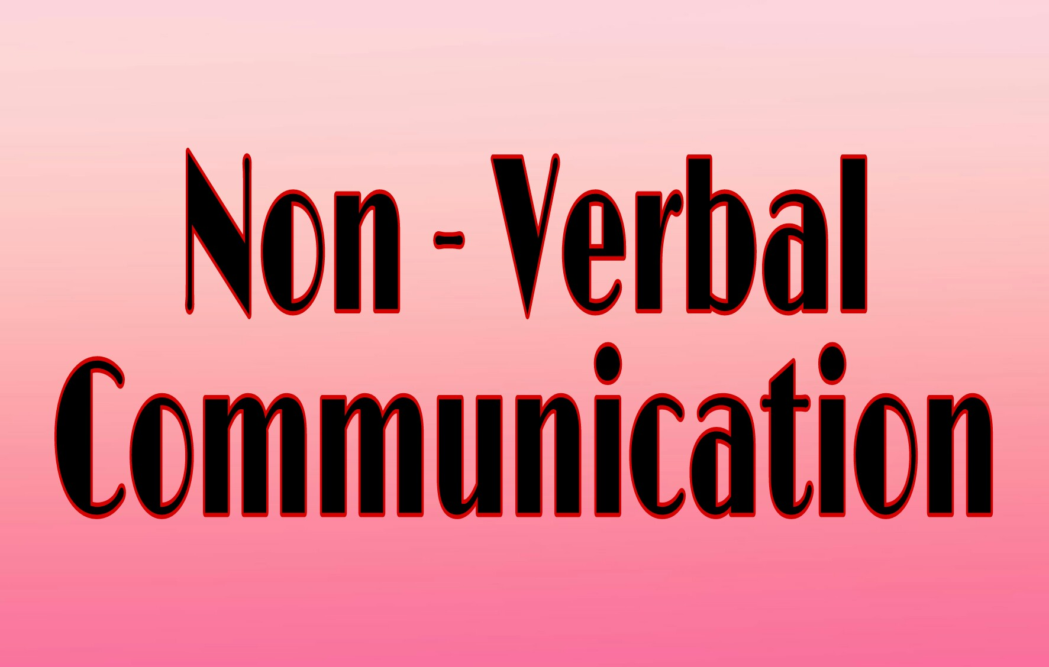

Slide 2
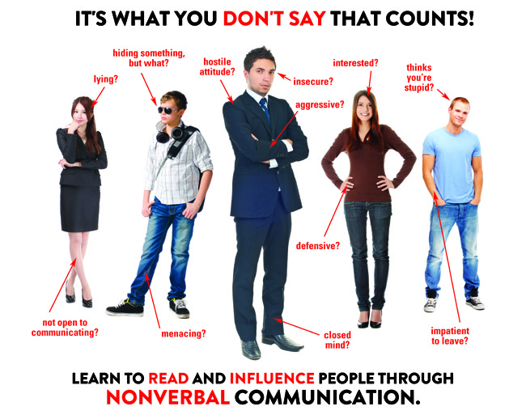
Non-verbal Communication :
Nonverbal communication bet'n people is communication through sending & receiving wordless clues.
It includes the use of visual cues such as body language (kinesics), distance (proxemics) and physical environments/appearance, of voice (paralanguage) and of touch (haptics). It can also include chronemics and oculesics.

Slide 3
Importance Of Non-Verbal Communication
1. Nonverbal communication represents two-thirds of all communications.
2. Nonverbal communication can portray a message both vocally & with the correct body signals.
3. Body signals comprise physical features, conscious and unconscious signals, & the mediation of personal space.
4. The wrong message can also be established if the body language conveyed does not match a verbal message.
5. Nonverbal communication strengthens a first impression in common situations like attracting a partner or in a business interview: impressions are on average formed within the first four seconds of contact.

Slide 4
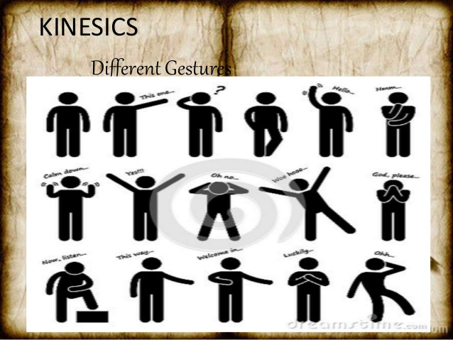
Kinesics :
We can define Kinesics as the study of th body's physical movements. In other words, it is the way
the body communicates without words, that is through various movements of itd parts.

Slide 5
Kinesics is the interpretation of body motion communication such as facial expressions and gestures, nonverbal behavior related to movement of any part of the body or the body as a whole.
The equivalent popular culture term is body language, a term Ray Birdwhistell, considered the founder of this area of study, neither used nor liked.

Slide 6

Eyes Contact :
Eye contact is the instance when two people look at each other's eyes at the same time; it is the
Eyes Contact
primary nonverbal way of indicating interest, atte-
ntion & involvement. Some studies have demonstra-
ted that people use their eyes to indicate interest.

Slide 7
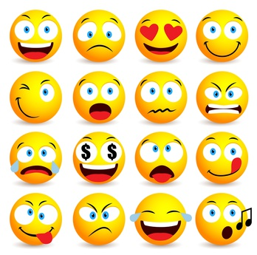
Face :
The face is where we look for most expressions of what is going inside us within
the facial area, the eyes tell us much more than other facial features. We look to the face when we want to determine much of the meaning body lang.

Slide 8
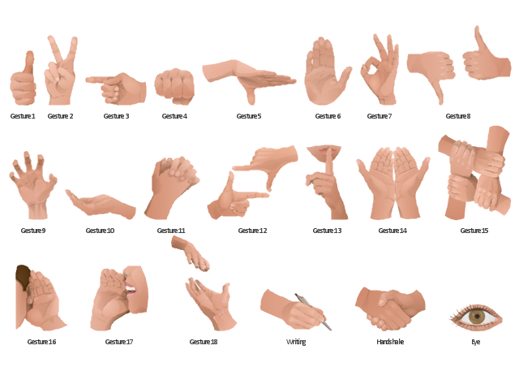
Gestures :
Gestures may be made with the hands, arms or body, & also include movements of the head, face & eyes, such as winking, nodding, or rolling one's eyes.
The most familiar are the so-called emblems or quotable gestures.

Slide 9
Gestures can also be categorized as either speech independent or speech related. Speech-independent gestures are dependent upon culturally accepted interpretation and have a direct verbal translation.
A wave or a peace sign are examples of speech-independent gestures. Speech-related gestures are used in parallel with verbal speech; this form of nonverbal communication is used to emphasize the message that is being communicated.

Slide 10
Postures :
There are many different types of body positioning to portray certain posturing including slouing, towering, legs spread, jaw thrust, shoulders forward, and arm crossing.The posture or bodily stance exhibited by individuals communicates a variety of messages whether good or bad.

Slide 11
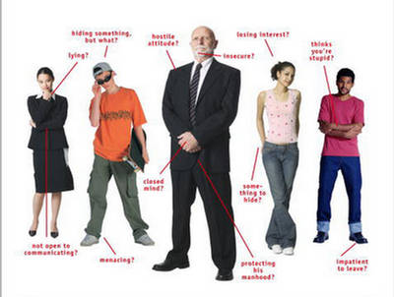
Posture can be used to determine a participant's degree of attention or involvement, the difference in status between cummuni-cator in and the level of fondness a person has for the other communicator, depending on body "openess".

Slide 12
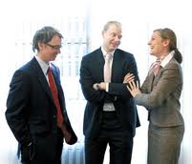
Proxemics
Proxemics is the study of the cultural, behav-ioral, and sociological aspects of spatial dis-
tances between individuals. .
Every person has a particular space that they keep to themselves when communicating, like a personal bubble.

Slide 13
There are four types of proxemics with different distances depending on the situation and people involved.
1.Intimate distance : is used for close encounters like embracing, touching, or whispering.
2. Personal distance is for interactions with close friends and family members.
3. Social distance is for interactions among acquaintances. It is mostly used in workplace or school settings where there is no physical contact.
4. Public distance is for strangers or public speaking.

Slide 14
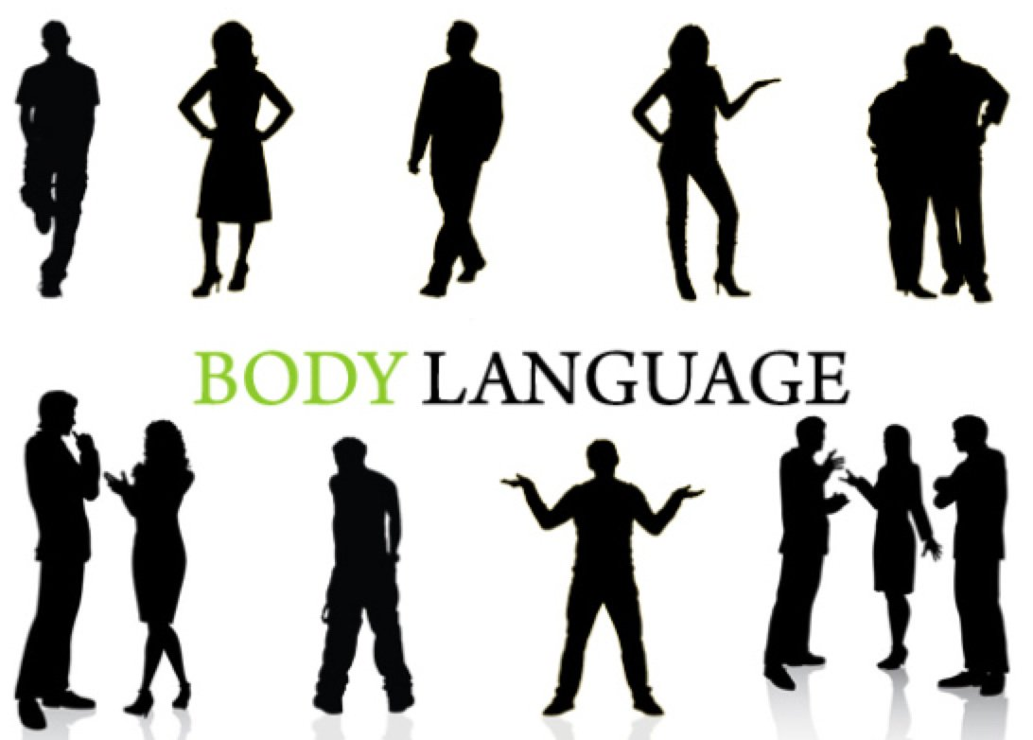
Body Language
Body language is a type of non-verbal communication in which physical behavior, as opposed to words, are used to express or convey information.Such behavior
include facial expression, body posture, gestures, eye movement, etc

Slide 15
Audio Signals in NVC
1. Paralanguage
2. Music
3. Alarms
4. Time
5. Touch

Slide 16
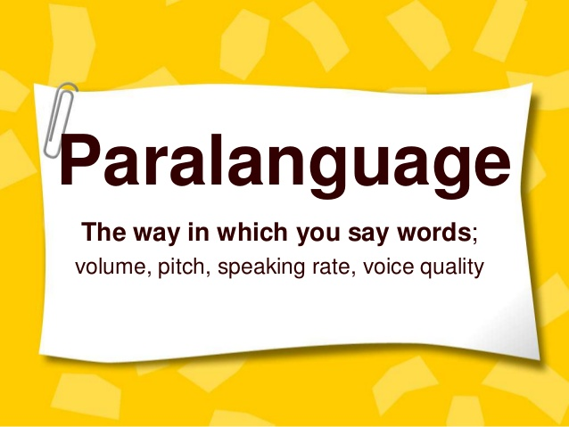

Para
Language
Body
Touch

Slide 17
Functions of N. V. C.
1. We use nonverbal communication to duplicate verbal communication. 2. We use nonverbal communication to replace verbal communication. 3. We use nonverbal cues to complement verbal communication. 4. We use nonverbal communication to accent verbal communication.

Slide 18
Advantages of N. V. C.
Complementary : Non-verbal cues complement a verbal message by adding to its meaning. You can pat someone you offended at the back as you say sorry to him or her.
Easy presentation : Information can be easily presented in non-verbal communication through using visual, audio-visual and silent means of non-verbal communication.
Substituting : Non-verbal message may substitute for the verbal message especially if it is blocked by noise, interruption, long distance etc. for example: gestures-finger to lips to indicate need for quite, facial expressions- a nod instead of a yes.
Accenting : Often used to accent a verbal message. Verbal tone indicates the actual meaning of the specific words.

Slide 19
Disadvantages of N. V. C.
imprecise : Non-verbal communication is quite vague and imprecise. Since in this communication there is no use of words or language which expresses clear meaning to the receiver. No dictionary can accurately classify them.
Continuous : It is possible to stop talking in verbal communication, but it is generally not possible to stop nonverbal cues. Also, spoken language has a structure that makes it easier to tell when a subject has changed, for instance or to analyze its grammar.
Difficult to understand: Difficult to understand and requires a lot of repetitions in non-verbal communication. Since it uses gestures, facial expressions eye contact, touch etc.
Multi-channel : while watching someone’s eyes, you may miss something significant in a hand gesture. Everything is happening at once and therefore it may be confusing to try to keep up with everything.

Slide 20
Thank You

